Slide 1

mis/disinformation in social media
understanding and addressing
a discussion with Spring 2026 EDU 498
Layout of our talk:
Background on our mis/disinformation professional development
Overview of our research study and a salient finding
Reflections/Questions
Amy Stell and Luke Hands
PhD students in Teaching and Curriculum

Slide 2
requests of the session
Ask questions: as we go through our slides and activities, please ask clarifying or inquiry questions as you feel is necessary Ways to participate: unmute and talk, type in the chat
norms that support healthy information lifestyles
we will seek out accurate information about things like health, science, and politics because accuracy matters to us and the people we care about we will talk to each other about why we find sources of information trustworthy or not we will not assume that when someone shares inaccurate or misleading information it means their values or beliefs are bad “free speech” ≠ false statements intended to mislead others, damage someone’s reputation, or cause conflict “fact checking” ≠ censorship; it counters inaccurate or misleading information rather than suppressing it

Slide 3
what are misinformation and disinformation?
false
intentionally harmful
misinformation
disinformation
malinformation
inaccurate, distorted, and/or out-of-context information, not shared in bad faith
purposefully fabricated, altered, or misrepresented information and/or context
private information distributed publicly to harass, endanger, or silence others
contingent on positions of power
contingent upon networks that enable spreading
“information disorder”
(Wardle & Derakhshan, 2017)

Slide 4

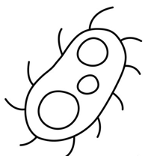

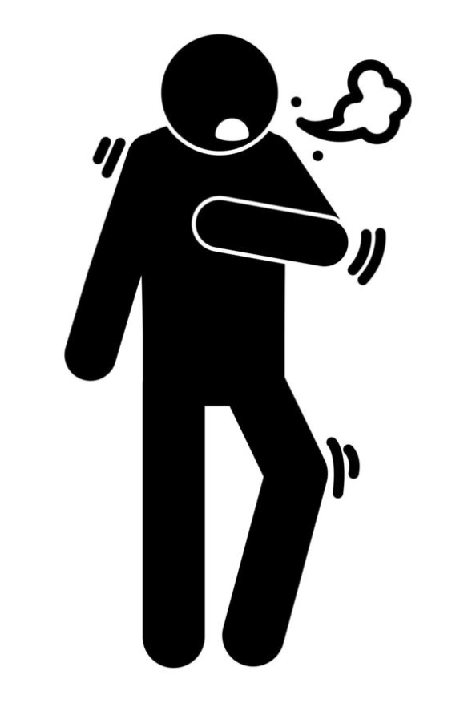
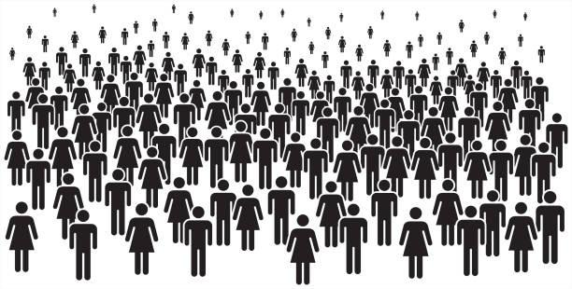
what are the effects of information disorder?
individual effects: exacerbates misperceptions, stereotypes, false beliefs, and cynicism toward information (e.g., “it’s all biased”)
social effects: reinforces and deepens affective polarization and division; generates mistrust in institutions (e.g., public agencies, knowledge producers); reduces our collective capacities to create, strengthen, and protect public goods (e.g., health, safety)

Slide 5
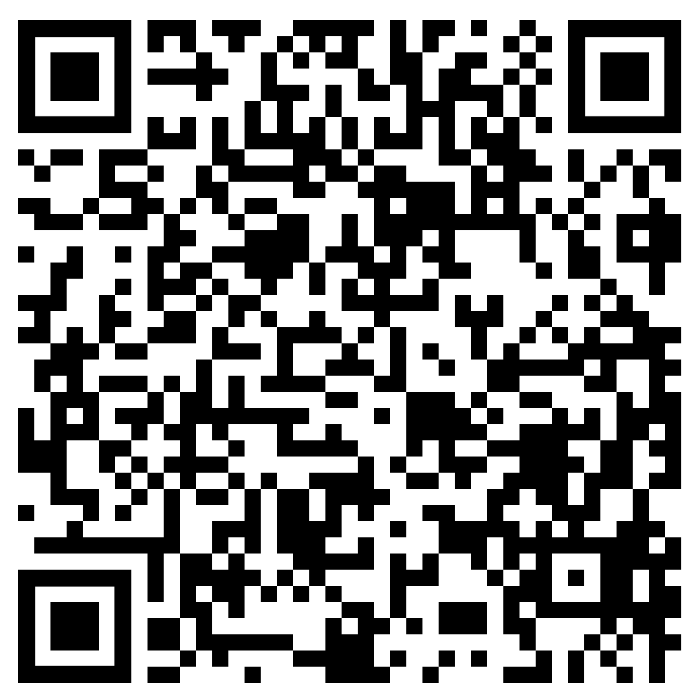
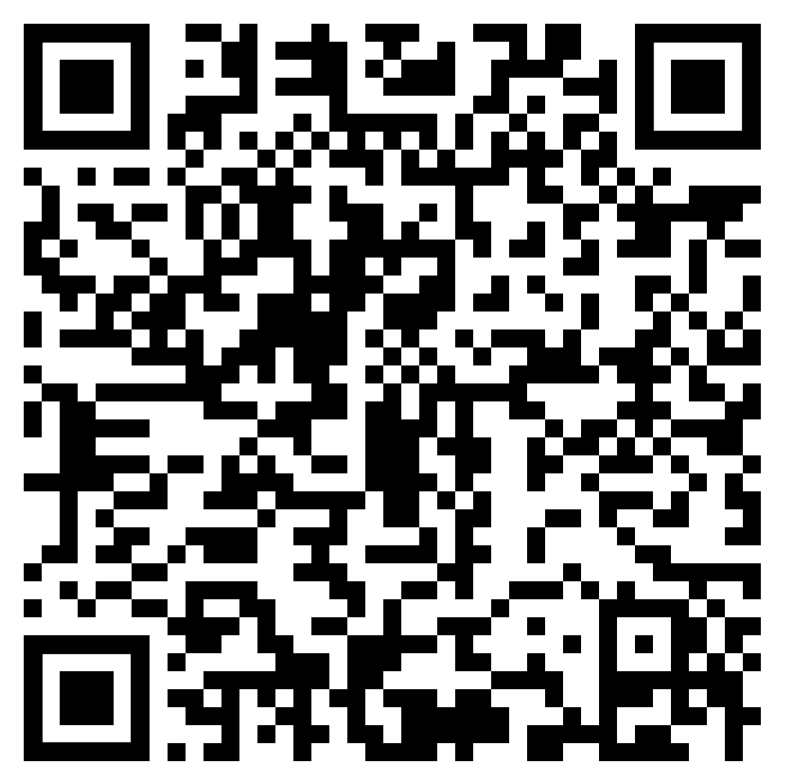
what could we do to address information disorder?
norms that support healthy information lifestyles
we will seek out accurate information about things like health, science, and politics because accuracy matters to us and the people we care about we will talk to each other about why we find sources of information trustworthy or not we will not assume that when someone shares inaccurate or misleading information it means their values or beliefs are bad “free speech” ≠ false statements intended to mislead others, damage someone’s reputation, or cause conflict “fact checking” ≠ censorship; it counters inaccurate or misleading information rather than suppressing it
treatment:
address the infection by removing the infectant (e.g., debunking) and correcting its effects in a targeted way
Lewandowsky, et al. (2020).
The Debunking Handbook.
lifestyle:
individual and social work to reduce conditions that make people susceptible to infection and strengthen conditions that make people resilient to infection
inoculation:
build resistance to an infectant by forewarning what infection entails and “microdosing” a refutation of disordered information (i.e., “prebunking”)
information disorder
inoculation resources

Slide 6
SIFT: a quick debunking strategy
(Caulfield & Wineburg, 2023)
S | Stop
I | Investigate the source
F | Find other coverage
T | Trace the claim to the original context
What is this? What is my initial emotional response to it; and why might that be my initial response?
Is this a trustworthy source? How would I quickly assess that?
Zoom out, and “read laterally” – is this information found in other credible sources?
Can I find out where and how this source got its information, originally?
Get ready to use your phones or laptops for the next slide.

Slide 7
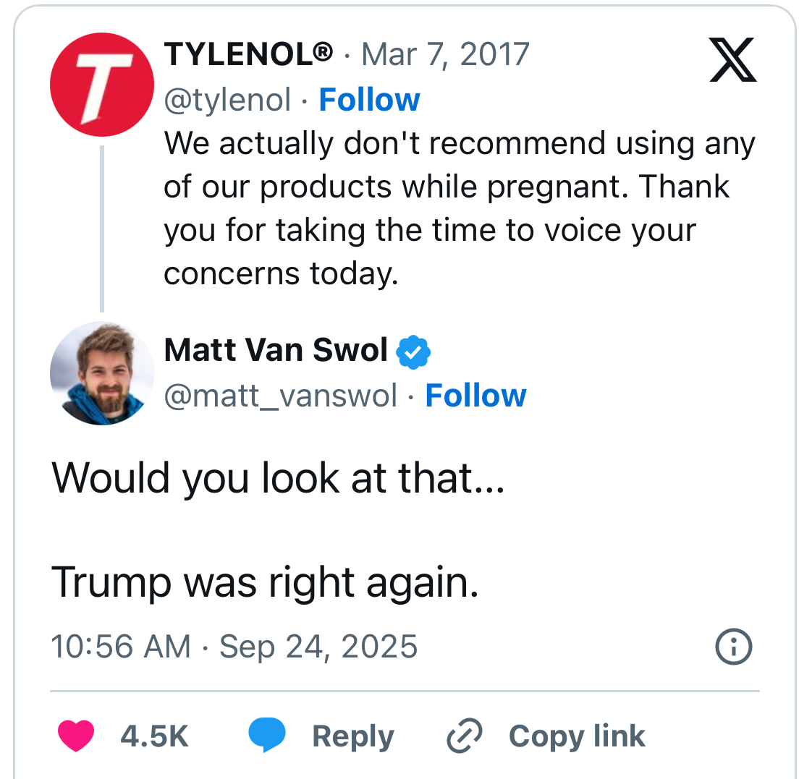
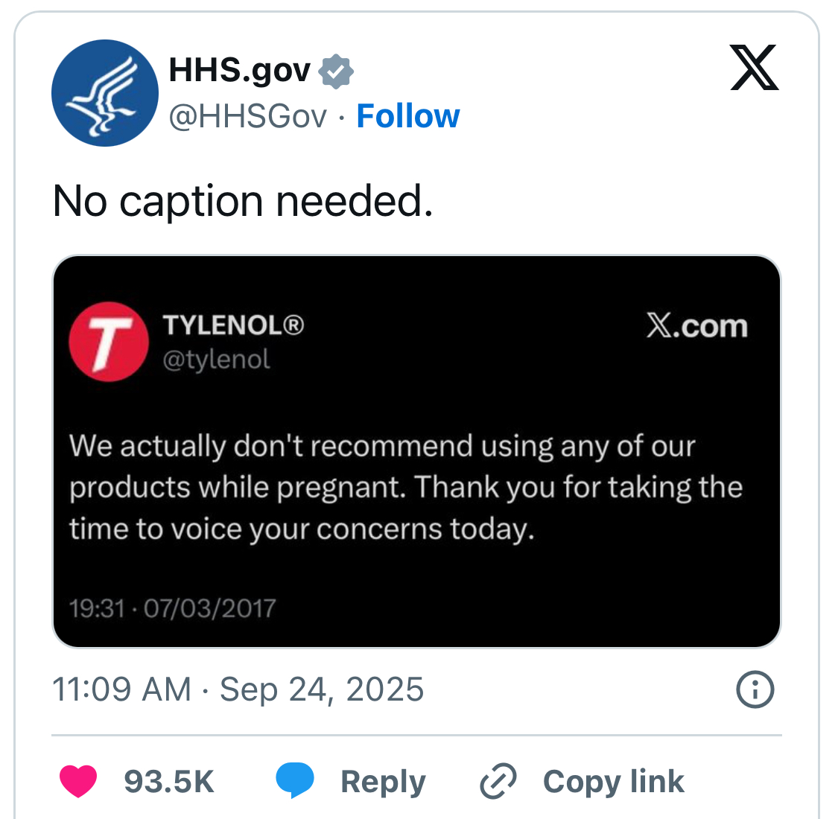
You try…
S | Stop
I | Investigate the source
F | Find other coverage
T | Trace the claim to the original context

Slide 8
Study purpose and research question
Problem space:
Information disorder is…
a macrosystemic, technologically dynamic, politically weaponizable, socially and cognitively overwhelming condition (1)
represented in educational spaces largely via individualistic (e.g., “learning to think/act like fact checkers”) and antiquated (e.g., “media literacy skills”) frames (2)
Research question:
How did cadre participants understand and manage conditions in their professional-ecological systems to set priorities for teaching and learning about mis/disinformation and act accordingly?
(1) e.g. Ecker, et al, 2025; Mihailidis & Viotty, 2017; Pennycook & Rand, 2021; Perez-Escolar, et al, 2023; van Bavel, et al, 2021; Wardle & Derakhshan, 2017
(2) e.g., Clark & Schmeichel, 2024; Garrett, Schmeichel, & Clark, 2025; Hodgin & Kahne, 2018; Journell, 2019 (Ed.), 2024; Wineburg, et al, 2022

Slide 9
THE ASYMMETRY – NEUTRALITY PARADOX
THE REALITY
THE CLASSROOM RESPONSE
Mis/Disinformation are NOT equally distributed.
Teachers gravitate toward “neutral” pedagogical tools.
Asymmetric sourcing
Conservative elites & right-wing media seed false content more frequently than liberal counterparts.
SIFT & Lateral Reading
"It's not politically charged. It's just… very simple."
— Kyle (teacher, 21 years experience)
Asymmetric spread
Mis/Disinformation spreads more broadly among conservatives, even after correction.
Why do teachers prefer procedurally neutral tools?
→ Avoid appearing partisan to parents, students, or administrators
Asymmetric amplitude
Right-wing media's reach in the information landscape outsizes other sources.
→ Mitigate risk of charges of “indoctrination”
→ Align with district directives to stay “middle-of-the-road”
DeVerna et al., 2024; Mosleh et al., 2024; Pérez-Escolar et al., 2023
THE ASYMMETRY–NEUTRALITY PARADOX | Meuwissen, Stell, Hands & Maslanka (2025)

Slide 10
DISCUSSION
A Question for You
“
Can you combat mis/disinformation and seek to be neutral in the classroom?
Consider: What is the difference between political neutrality and epistemological neutrality?
Consider: Does treating MDI as a "both sides" issue misrepresent the actual information landscape?
Consider: What risks do teachers take when they choose neutrality — and when they don't?
Context: Meuwissen, Stell, Hands & Maslanka (2025) — Teachers' Navigation of Professional-Ecological Conditions Associated with Combating Mis/Disinformation in Secondary Classrooms

Slide 11
Reflections, Questions, Connections?
Contact us at:
Amy Stell astell@u.rochester.edu
Luke Hands lhands@u.rochester.edu

